Slide 1
HackedDB*: All your database are belong to us * HackedDB is not a real db ☺
#revconf
David Makogon, Microsoft
twitter: @dmakogon, blog: dmak.io

Slide 2


Who am I??? (hint: → David Makogon)
Azure architect
Camera carrier
Pun penner
NoSQL non-novice
Community congrat collector
- (World's first former) Azure MVP
- (Former) MongoDB Master
- Neo4j Ambassador
The stenographer was convicted of a crime, but received a shortened sentence...

Slide 3



Slide 4
For your architect-hat-covered brain today:
Setting the stage
Un-hackable-ing databases
What this isn't about (but still important)
Your own passwords
Your personal data being hacked somewhere else

Slide 5
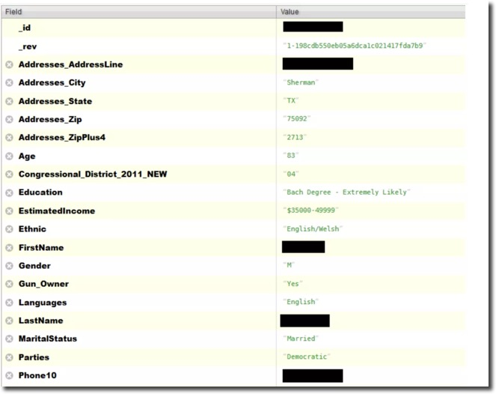


So much data, so much taken!

Slide 6
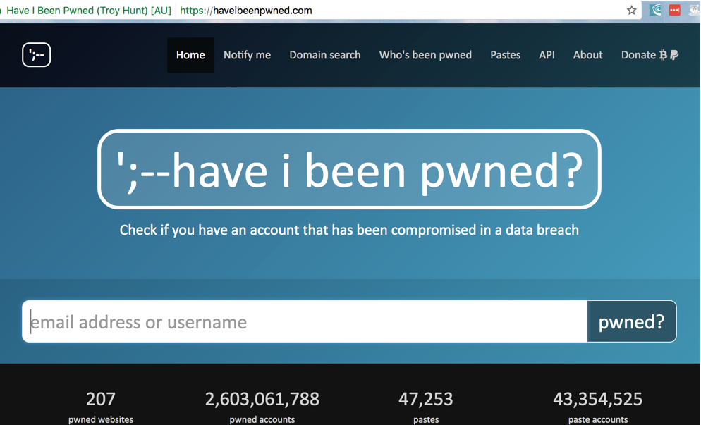
Your data will be...
Deleted
Held for ransom
Sold

Slide 7
Today's focus: LOCKDOWN
How will you, as DB owner, avoid hackage?
We'll look at LOW HANGING FRUIT!
Database security
Virtual networks
IP whitelisting
Jumpbox

Slide 8




But first: our fictitious setup
Azure
DB
Web app

Slide 9
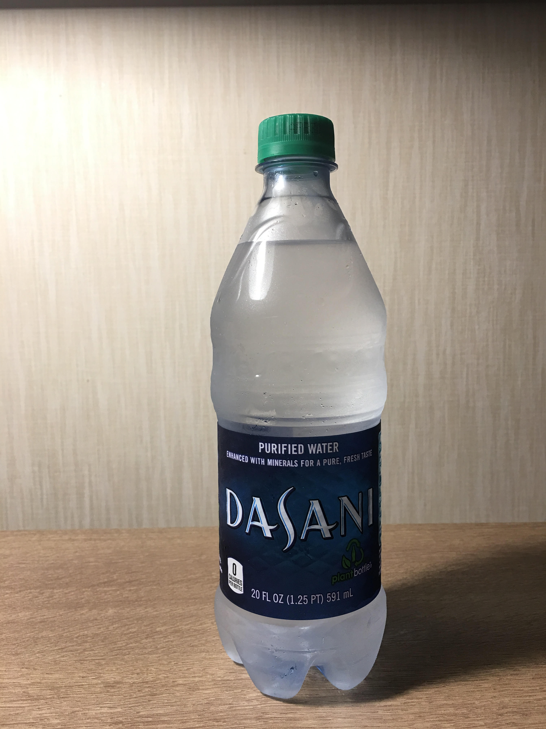
Oh – let's see an actual hacked database
Actually, double-hacked
(blame it on the water-bottle run)

Slide 10
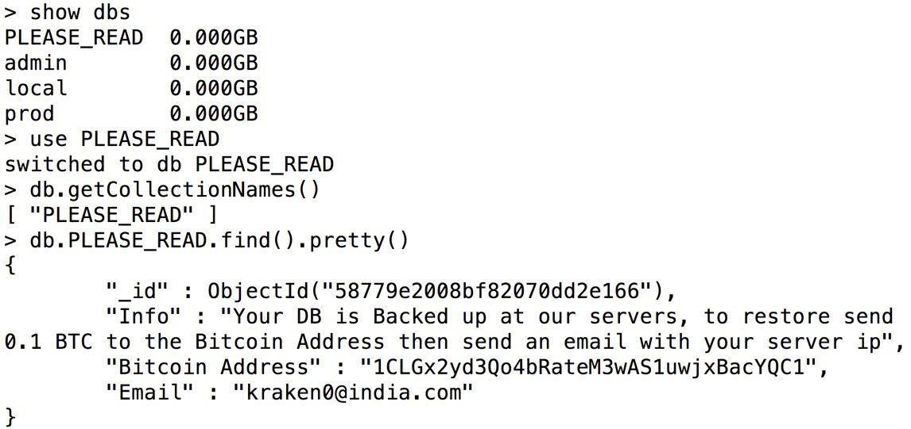

Slide 11
Database security
Your database = Shiny New Object
You rip open the packaging…
You install your brand new database…
Aaaaaaand…
Is it secure?

Slide 12
Out-of-the-box database security
Authentication (and authorization)
Network binding
Some db’s default to:
No auth
All bindings (meaning every network interface)

Slide 13
Demo – MongoDB config

Slide 14
Virtual Networks
Azure
DB
App

Slide 15
Virtual Networks
App server talks to db
app & db server live in vnet
no ports exposed for db
app server has only open port
443

Slide 16
Demo – Virtual Networks

Slide 17
Jump box
Azure
22 3389
DB
Jumpbox
App

Slide 18
Demo – Jumpbox

Slide 19

IP whitelisting
Azure
DB
App

Slide 20
Demo – IP Whitelisting

Slide 21
Sooo... are we un-hackable yet?
Database security
Virtual networks
IP whitelisting
Jumpbox

Slide 22
Questions?
Twitter: @dmakogon
Blog: dmak.io
Facebook: facebook.com/dmak.online
StackOverflow: david-makogon
Azure stuff at Azure.com
Talk stuff at github.com/dmakogon/revconf2017

